Slide 1
PRINCIPLES OF PROGRAMMING
Features of Programming Languages

Slide 2
Contents
Data types
Names
variables
Bindings
Scopes

Slide 3
Data Types
Data type is classification of a particular type of information.
Data types are essential to any computer programming language.
Without them, it becomes very difficult to maintain information within a computer program.
Different data types have different sizes in memory depending on the machine and compilers.

Slide 4
Data types
very important concept available in almost all the programming languages
As its name indicates, a data type represents a type of the data which you can process using your computer program.
It can be numeric, alphanumeric, decimal, etc.

Slide 5
Data types
Let’s keep Computer Programming aside for a while and take an easy example of adding two whole numbers 10 & 20, which can be done simply as follows −
10 + 20
Let's take another problem where we want to add two decimal numbers 10.50 & 20.50, which will be written as follows −
10.50 + 20.50

Slide 6
Data types
The two examples are straightforward. Now let's take another example where we want to record student information in a notebook. Here we would like to record the following information −
Name: Zara Ali
Class: 6th
Section: J
Age: 13
Sex: F

Slide 7
Data types
The first example dealt with whole numbers, the second example added two decimal numbers, whereas the third example is dealing with a mix of different data. Let's put it as follows −
Student name "Zara Ali" is a sequence of characters which is also called a string.
Student class "6th" has been represented by a mix of whole number and a string of two characters. Such a mix is called alphanumeric.

Slide 8
Data Types
Student section has been represented by a single character which is 'J'.
Student age has been represented by a whole number which is 13.
Student sex has been represented by a single character which is 'F'.

Slide 9
Primitive Data Types
Integer: Keyword used for integer data types is int.
A whole number, a number that has no fractional part.
Examples of Integers: 0 1 -125 144457
The following are not integers: 5.34 -1.0 1.3E4 "string"
Integers typically requires 4 bytes of memory space and ranges from -2147483648 to 2147483647.

Slide 10
Primitive Data Types
Character: Character data type is used for storing characters.
Keyword used for character data type is char.
Examples: a A @ $
Characters typically requires 1 byte of memory space and ranges from -128 to 127 or 0 to 255.

Slide 11
Primitive Data Types
Boolean: Boolean data type is used for storing boolean or logical values.
A boolean variable can store either true or false.
Keyword used for boolean data type is bool.

Slide 12
Primitive Data Types
Floating Point: Floating Point data type is used for storing single precision floating point values or decimal values.
Keyword used for floating point data type is float.
Float variables typically requires 4 byte of memory space.

Slide 13
Primitive Data Types
Double Floating Point: Double Floating Point data type is used for storing double precision floating point values or decimal values.
Keyword used for double floating point data type is double.
Double variables typically requires 8 byte of memory space.

Slide 14
Primitive Data Types
String is a sequence of character.
Example:
– Kuala Lumpur
– John White
– Computer

Slide 15
Variables
A symbol or name that stands for a value.
A variable is a value that can change.
Variables provide temporary storage for information that will be needed during the lifespan of the computer program (or application).

Slide 16
Variables
Variables are used to store information to be referenced and manipulated in a computer program.
They also provide a way of labeling data with a descriptive name, so our programs can be understood more clearly by the reader and ourselves.
It is helpful to think of variables as containers that hold information.

Slide 17
Variables
In a program every, variable has:
– Name (Identifier)
– Data Type
– Size
– Value
Their sole purpose is to label and store data in memory.
This data can then be used throughout your program.

Slide 18
Variable Scope
A variable's scope determines where in a program a variable is available for use.
A variable's scope is defined by where the variable is initialized or created.
A variable scope is defined by a block.
A block is a piece of code following a method invocation, usually delimited by either curly braces {} or do/end.

Slide 19
Variable scope
Based on the scope of the variables we have the following types of variables: -
Local variables
Global variables

Slide 20
Local Variables
Are those that are in scope within a specific part of the program (function, procedure, method, or subroutine, depending on the programming language employed).
Variables that are declared inside a function or block are local variables.
They can be used only by statements that are inside that function or block of code.
Local variables are not known to functions outside their own

Slide 21
Global variables
Are those that are in scope for the duration of the programs execution
Global variables are defined outside of all the functions, usually on top of the program.
The global variables will hold their value throughout the life-time of your program.
A global variable can be accessed by any function.
That is, a global variable is available for use throughout your entire program after its declaration

Slide 22
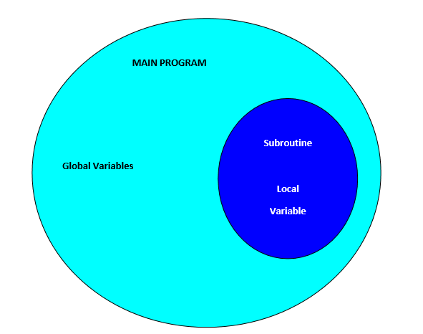
Types of variables

Slide 23
Naming
In computer programming, a naming convention is a set of rules for choosing the character sequence to be used for identifiers which denote variables, types, functions, and other entities in source code and documentation.

Slide 24
Naming
Design issues for names:
Length
Are names case sensitive?
Are special words reserved words or keywords?

Slide 25
Names (continued)
Length
If too short, they cannot be connotative

Slide 26
Names (continued)
Case sensitivity
Disadvantage: readability (names that look alike are different)
worse in C++ and Java because predefined names are mixed case (e.g. IndexOutOfBoundsException)
C, C++, and Java names are case sensitive
The names in most other languages are not

Slide 27
Names (continued)
Special words
An aid to readability; used to delimit or separate statement clauses
A keyword is a word that is special only in certain contexts, e.g., in Fortran
Real VarName (Real is a data type followed with a name, therefore Real is a keyword)
Real = 3.4 (Real is a variable)
A reserved word is a special word that cannot be used as a user-defined name

Slide 28
Naming the variables
The best naming convention is to choose a variable name that will tell the reader of the program what the variable represents
All variable names must begin with a letter of the alphabet or an underscore( _ ).
For beginning programmers, it may be easier to begin all variable names with a letter of the alphabet.
After the first initial letter, variable names can also contain letters and numbers.

Slide 29
Naming the variables
It should not be a reserved word.
Examples of reserved word:
-main
-long
-if
-do
-continue
-short
-else
-return etc.

Slide 30
Naming the variables
Uppercase characters are distinct from lowercase characters.
Using all uppercase letters is used primarily to identify constant variables.
Examples of variable names:-
Samples of acceptable variable names: | Samples of unacceptable variable names:
Grade name | Grade(Test)
GradeOnTest | GradeTest#1
Grade_On_Test | 3rd_Test_Grade 123

Slide 31
Variables Declaration
In programming languages all the variables that a program is going to use must be declared prior to use.
Declaration of a variable serves two purposes:
– It associates a type and an identifier (or name) with the variable. The type allows the compiler to interpret statements correctly.
– It allows the compiler to decide how much storage space to allocate for storage of the value associated with the identifier and to assign an address for each variable which can be used in code generation.

Slide 32
Variables Declaration
In programming, a declaration is a statement describing an identifier, such as the name of a variable or a function. ... For example, in the C++ programming language, all variables must be declared with a specific data type before they can be assigned a value.
Syntax for declaring a variable
dataType variableName;

Slide 33
Variable declaration
Examples
int name;
float number;
double number2;
string name;
bool total;

Slide 34
Variable Initialization
Giving a value to a variable is known as variable initialization
Naming variables is known as one of the most difficult tasks in computer programming.
When you are naming variables, think hard about the names.
Try your best to make sure that the name you assign your variable is accurately descriptive and understandable to another reader.

Slide 35
Variable Initialization
Sometimes that other reader is yourself when you revisit a program that you wrote months or even years earlier.
When you assign a variable, you use the = symbol.
The name of the variable goes on the left and the value you want to store in the variable goes on the right.
string name =“Juma”;
int number=12;

Slide 36
Named Constants
In computer programming, a constant is a value that cannot be altered by the program during normal execution, i.e., the value is constant.
This is contrasted with a variable, which is an identifier with a value that can be changed during normal execution, i.e., the value is variable.
Syntax
const data type constant_name;
Example: const float PI = 3.14;

Slide 37
Assignment
Are these identifiers valid or not? Explain.
a1
Number3
123abc
a_123
no 2

Slide 38
Assignment
Identify the data type for each of the following values: -
312
2.153
a1
a
True
hello

Slide 39
Assignment
Explain these mathematical problems by using variables.
Area of square
Area of triangle
Area of circle
Average speed

Slide 40
END

